Slide 1
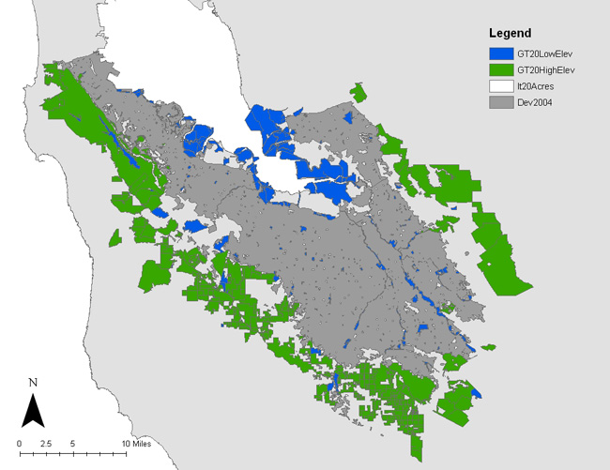
Figure 3. Three conserved parcel types.

